Slide 1
UNIFIED ENDPOINT MANAGEMENT
UEM Console 1906
June 2019

Slide 2
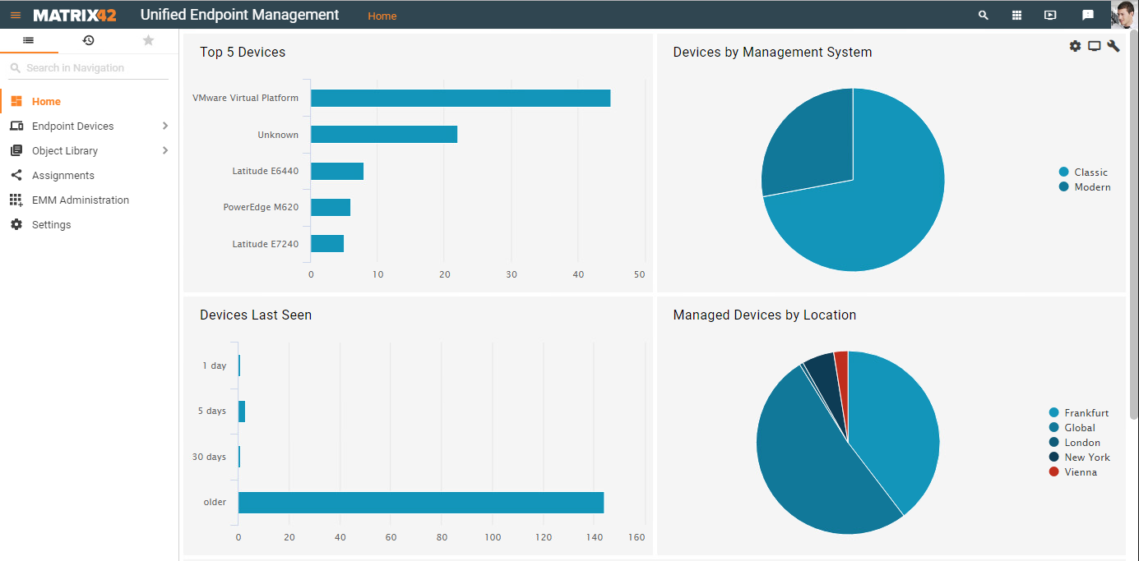
Matrix42 UEM Console
Software rollouts in a modern web console for all device types.

Slide 3
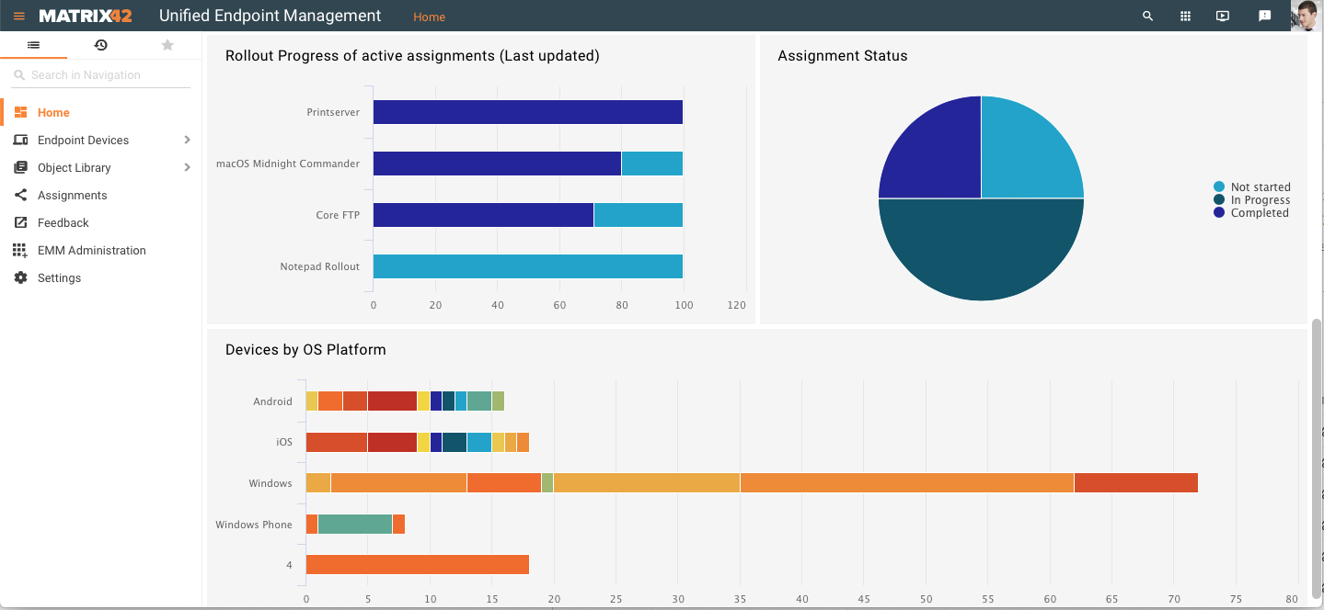
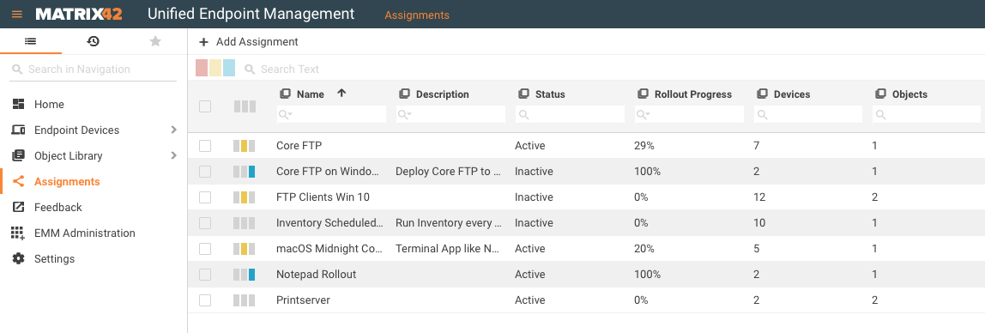
UEM Console 1906
The new UEM Console will be installed based on the very flexible Matrix42 Solution Builder platform.
Comprehensive search, filter and grouping optimize the handling of device lists.
Easy operation facilitates access to new functions.
Furthermore the "three Empirum columns“ - only interpreted differently.

Slide 4
Highlights
Create and schedule assignments in modern Web UI
Common database with Matrix42 Service and Software Asset Management
Assignments are rolled out in the background via Empirum
Quickly informed through dashboards
Rollout status - how far is the distribution?
Wave Rollouts - Step-by-Step Activation

Slide 6
How to start
Service Store (UUX) Version 9.1/9.1.1 & all supported Empirum and Silverback versions.
Download of the UEM Console from Matrix42 Marketplace https://marketplace.matrix42.com/details/uem-console/
Monthly new versions available in Marketplace

Slide 7
Outlook
Extended database through conversion of the Empirum Connector to the modern Data Provider Framework
Integration of Log Information with a new Message Queue System
Nearly real time update
Transmission of installation steps and status messages
Extended predefined roles and rights
Unification of device types (CI) computer and mobile to support hybrid types in the platform
Assignment of Silverback Applications, Restrictions and Policies
Dynamic assignments based on saved searches/queries

Slide 8
THANK
YOU
www.matrix42.com

